Slide 1


Web Scrapping and EDA on Food Restaurant details from

Slide 2




I enjoy talking about Data..
Aryan Madchetti
B.Tech, Computer Engineering
DY Patil University, Pune, Ambi

Slide 3


Problem Statement or Business Questions
What types of cuisines are most offered in different areas of a city?
Which areas or localities have the highest concentration of top-rated restaurants?
Which restaurant categories (e.g., cafes, fine dining, casual) offer the best discounts or highest ratings?
Use Cases and Applications
City-wise Food Guide
Food Delivery Startup Insights
Investor/Franchise Planning

Slide 4
Objective
The objective of this project is to automate the extraction of restaurant data from EazyDiner using web scraping techniques and transform it into a structured dataset.
This dataset is then used to perform exploratory data analysis (EDA) on key features such as ratings, cuisines, locations, discounts, and pricing across multiple major Indian cities.
The goal is to uncover meaningful patterns, trends, and insights that can inform consumer behavior, regional preferences, and market opportunities in the urban food industry.

Slide 5

Web Scrapping Details

Slide 6
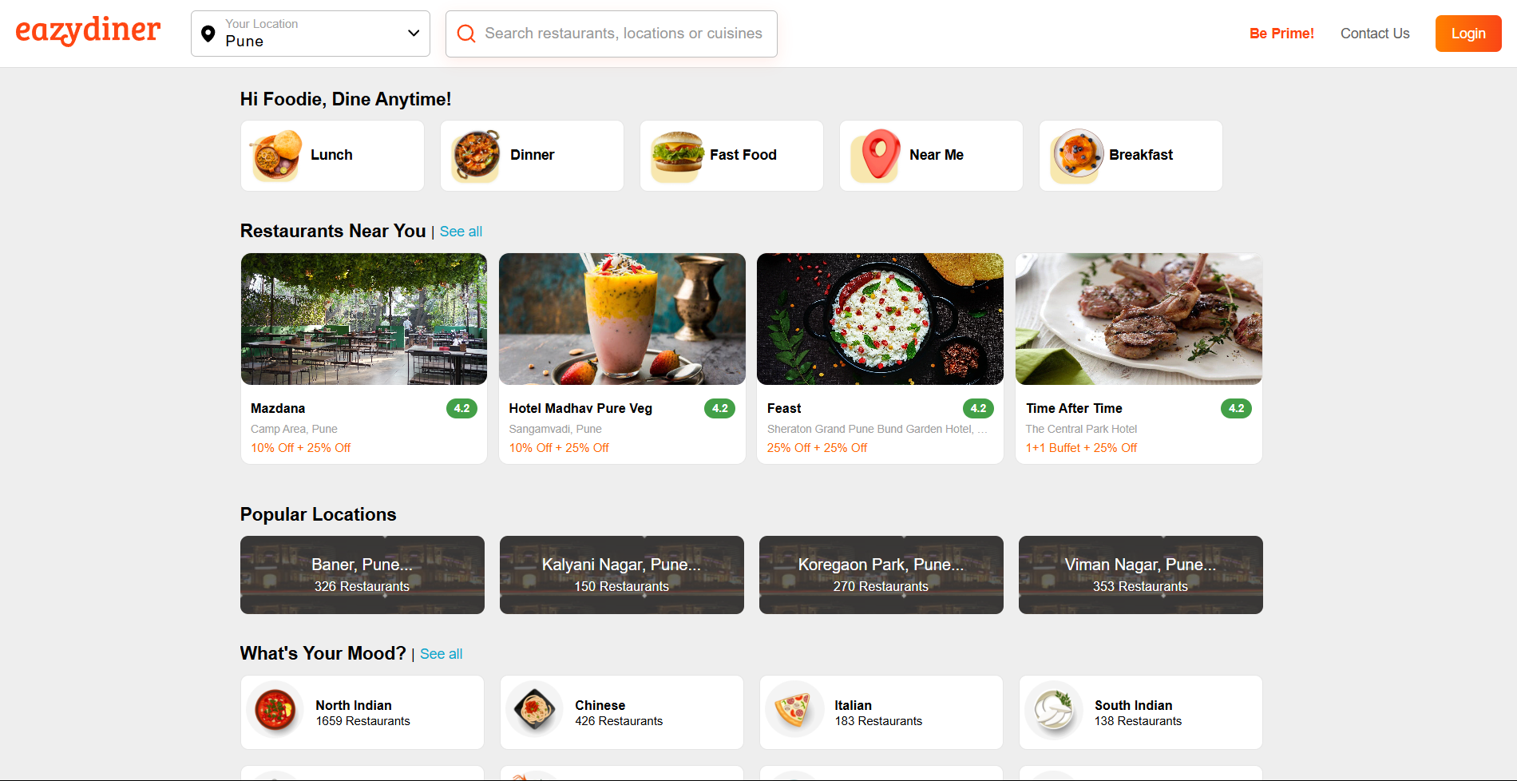
The website used for Web Scrapping and obtained the data from –
https://www.eazydiner.com/

Slide 7

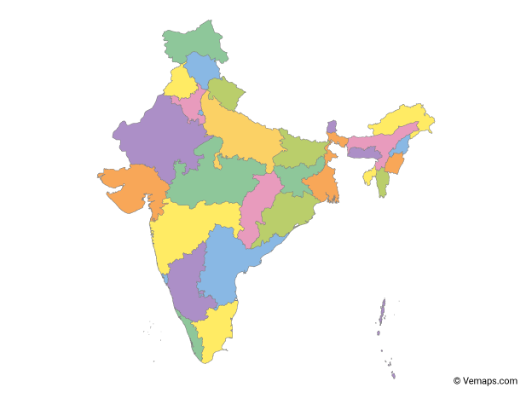




I have extracted details of restaurants from 4 major cities in India – Ahmedabad, Mumbai, Pune, Bengaluru
Ahmedabad
Mumbai
Pune
Bengaluru

Slide 8
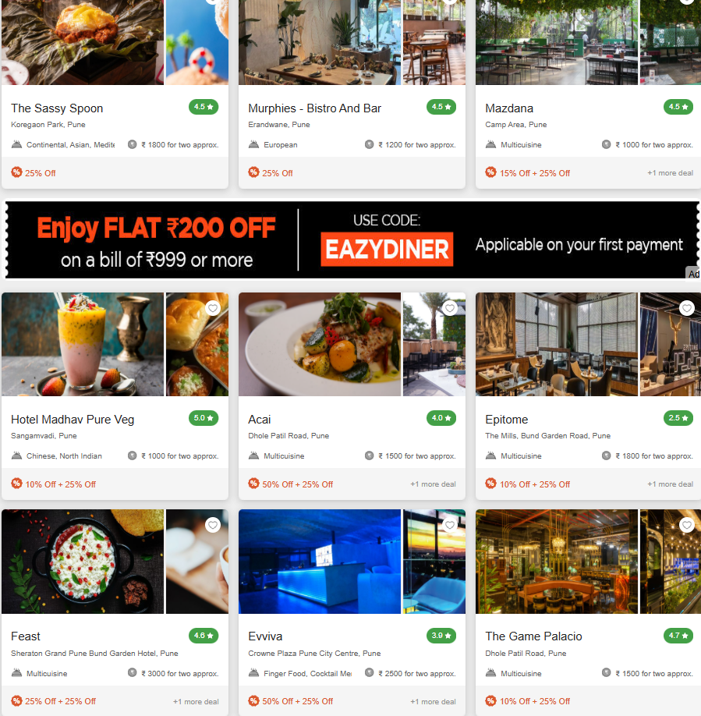
Each page consists of 9 restaurant cards.
Scrapped 15 pages per city.
From each city details of 135(9 x 15) food places.
Making a total sample data of 540(135 x 4) restaurants.

Slide 9
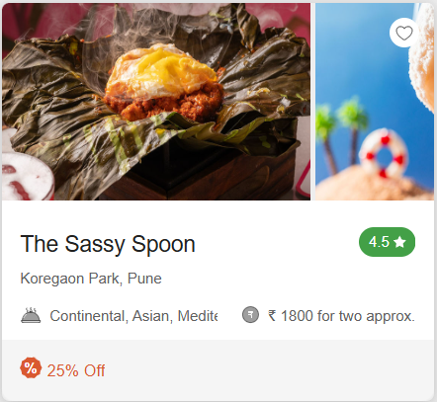
Features Extracted :
Name of the restaurant
Rating
Cuisine served
Location
Approximate cost for 2
Discount

Slide 10
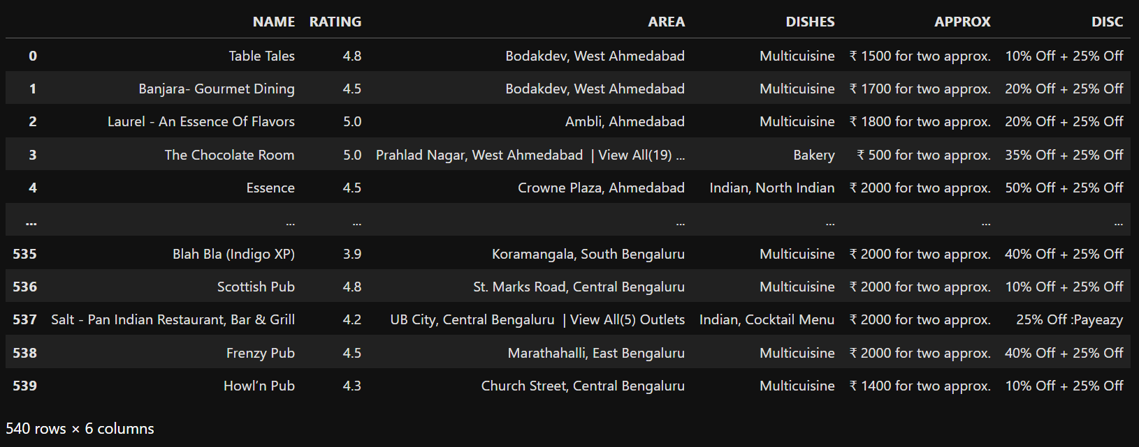
First look at the Data :

Slide 11

Data Cleaning
and
Data Manipulation

Slide 12
Looks good enough
Cleaning required to gain insights

Slide 13
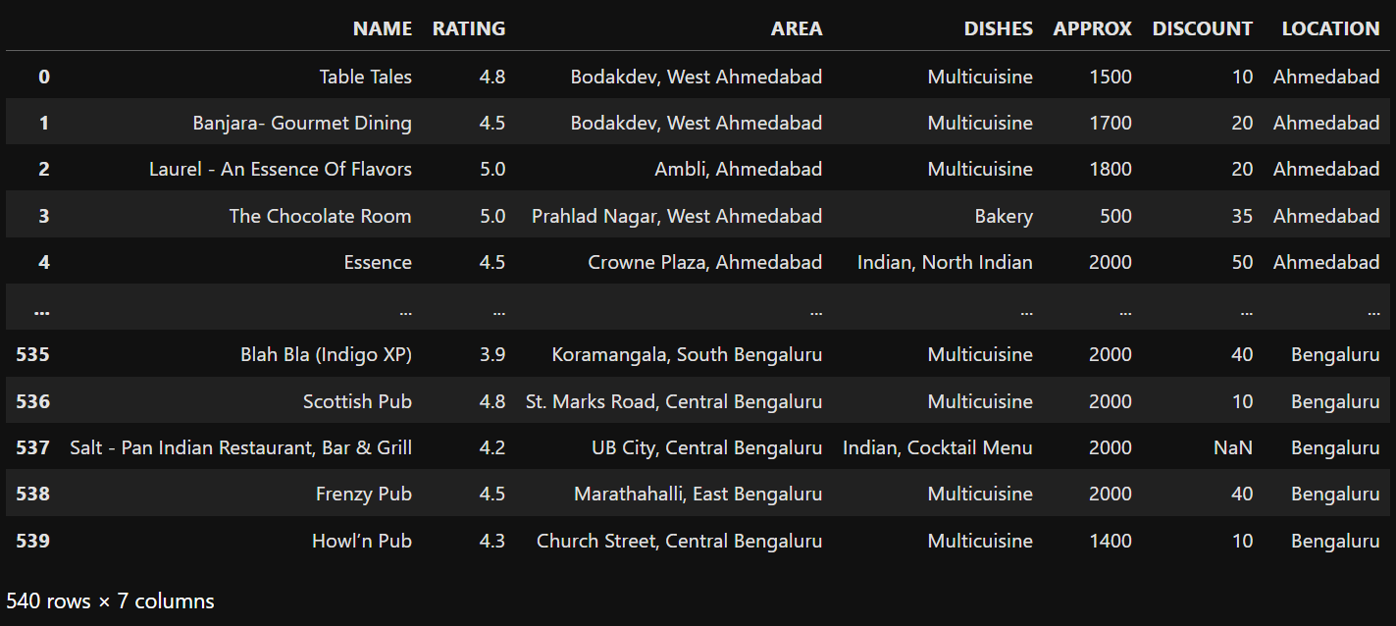
Cleaning of AREA column :

Slide 14
Cleaning of APPROX column :

Slide 15
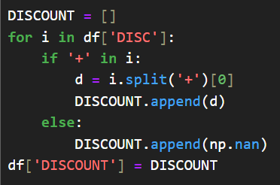
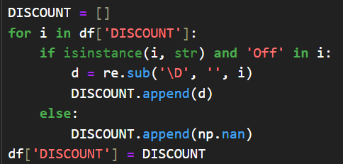
Cleaning of DISCOUNT column :

Slide 16
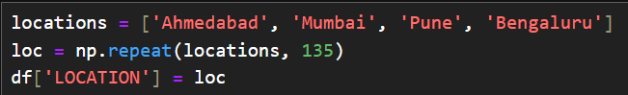
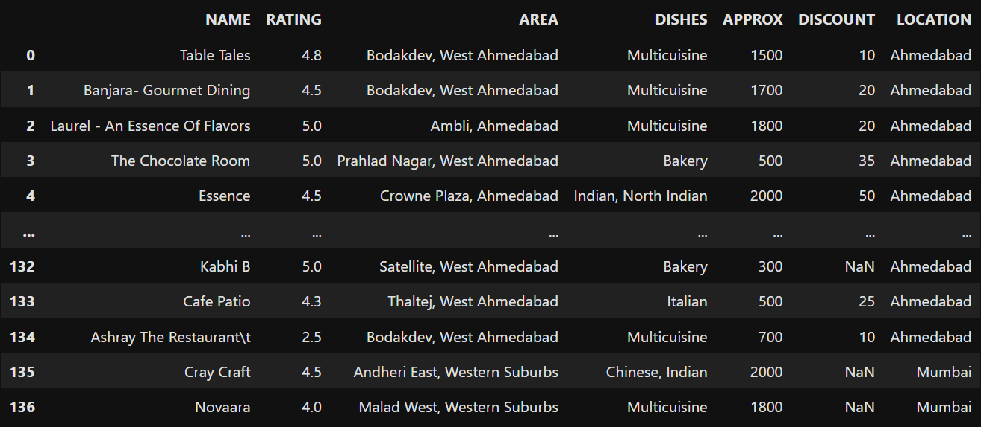
Deriving new column LOCATION :

Slide 17
Final look of the Data :

Slide 18

Exploratory
Data Analysis

Slide 19
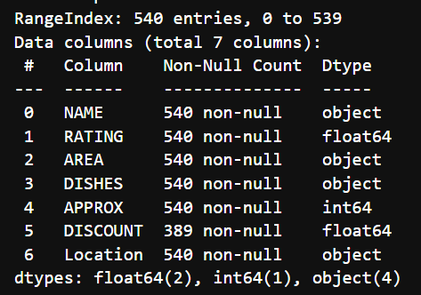
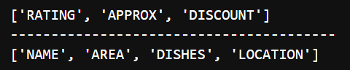
Numerical columns
Categorical columns

Slide 20


Univariate Analysis

Slide 21
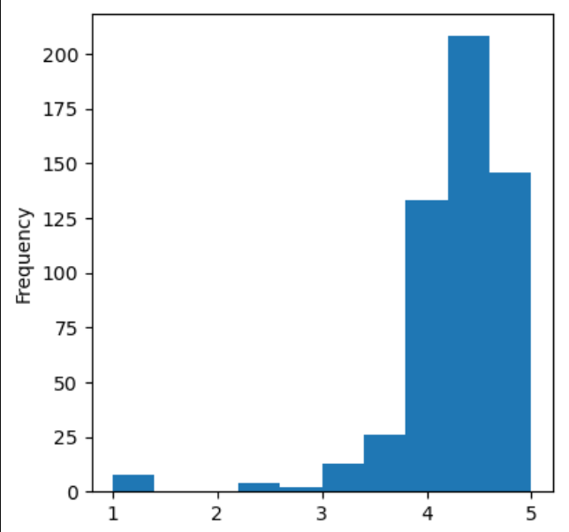
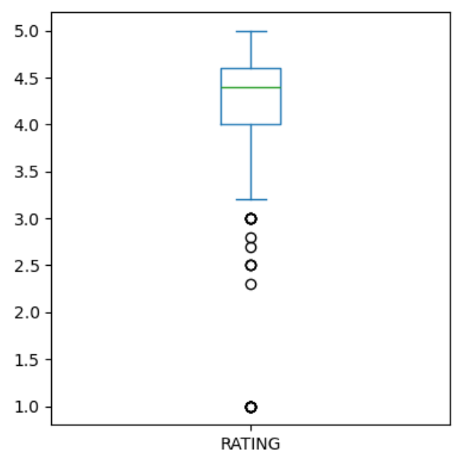
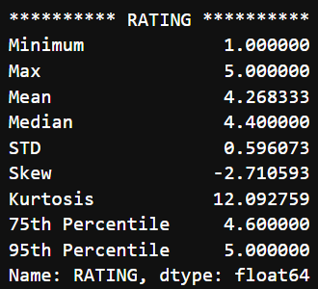

Slide 22
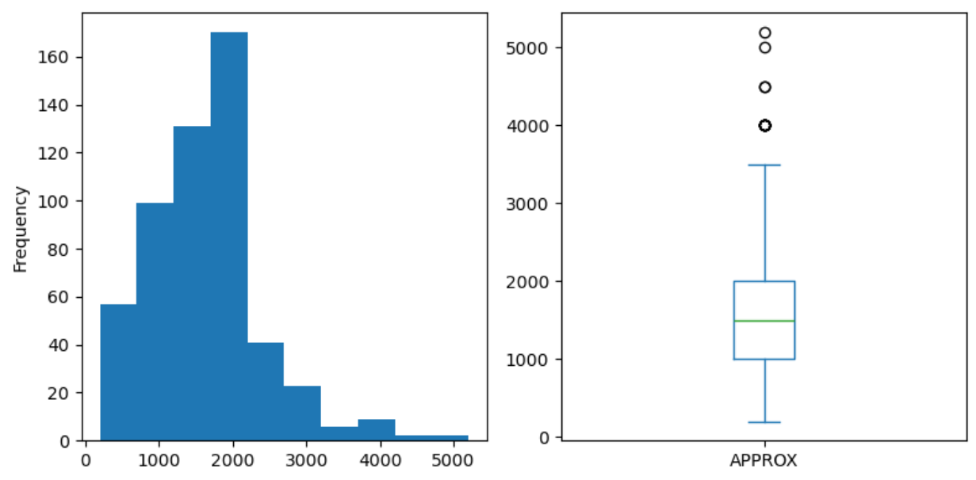
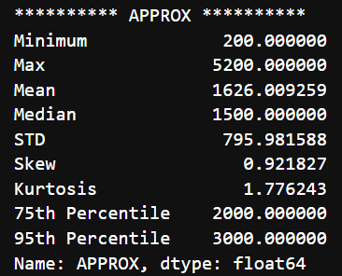

Slide 23
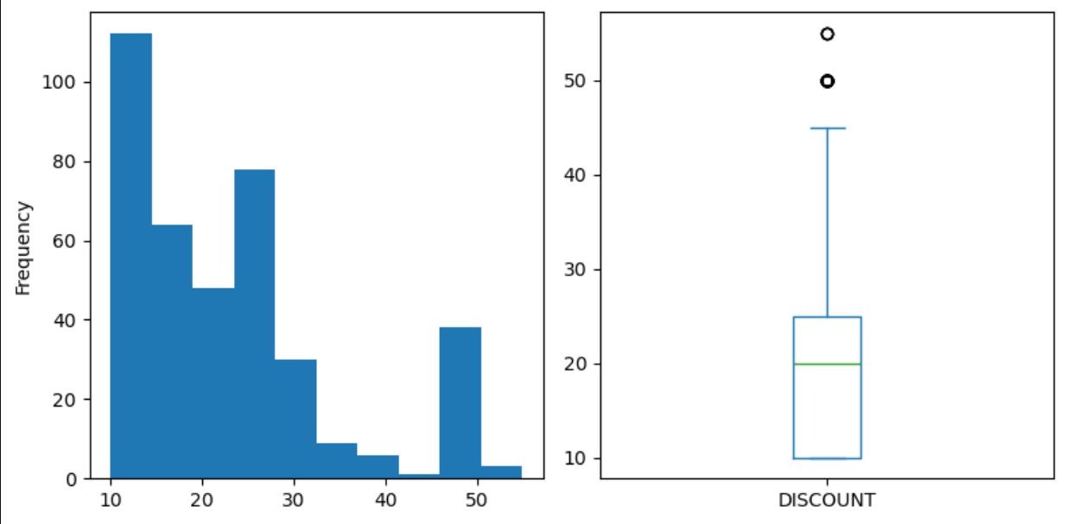
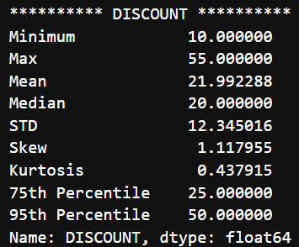

Slide 24
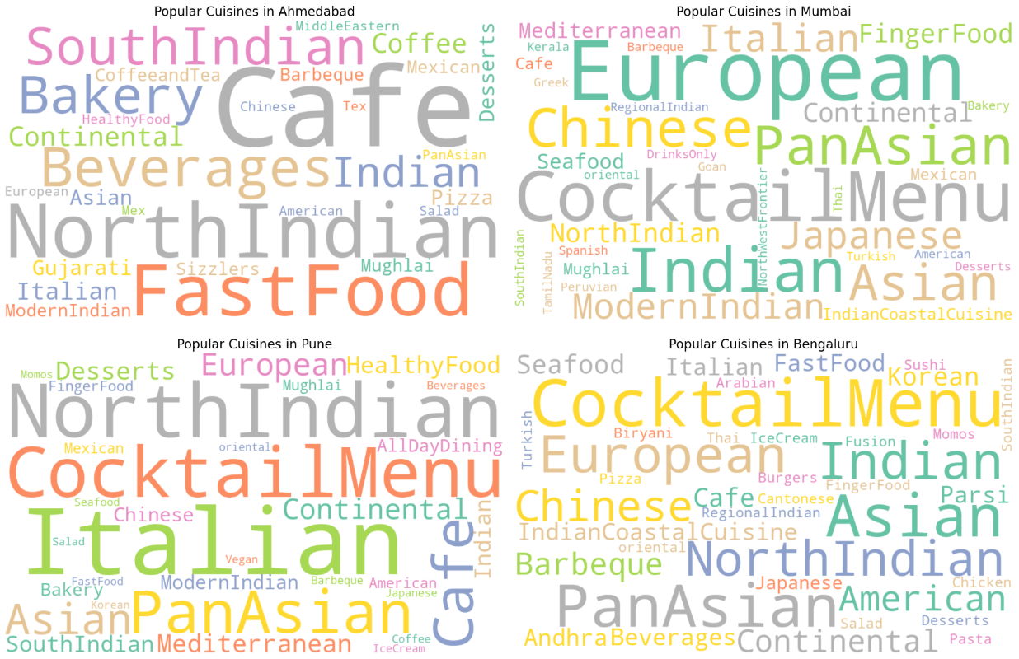
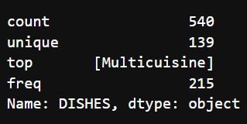

Slide 25


Bivariate Analysis

Slide 26
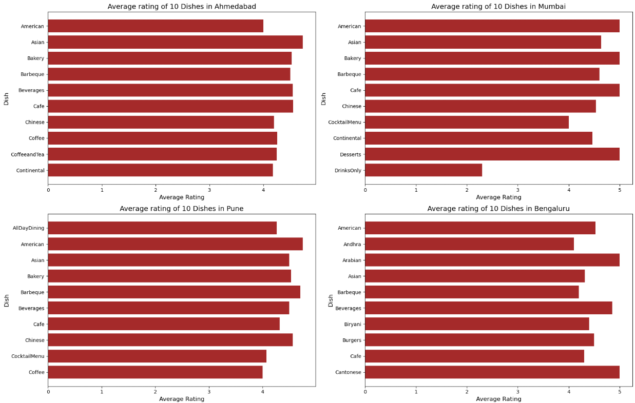
Average Rating of Dishes in each City

Slide 27
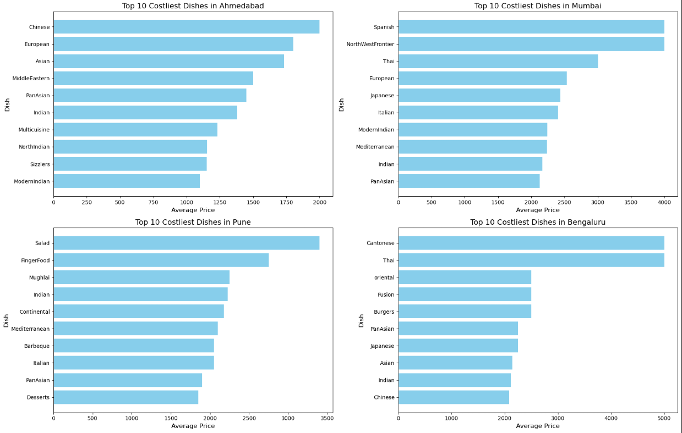
Top 10 Average Dish Prices per City

Slide 28
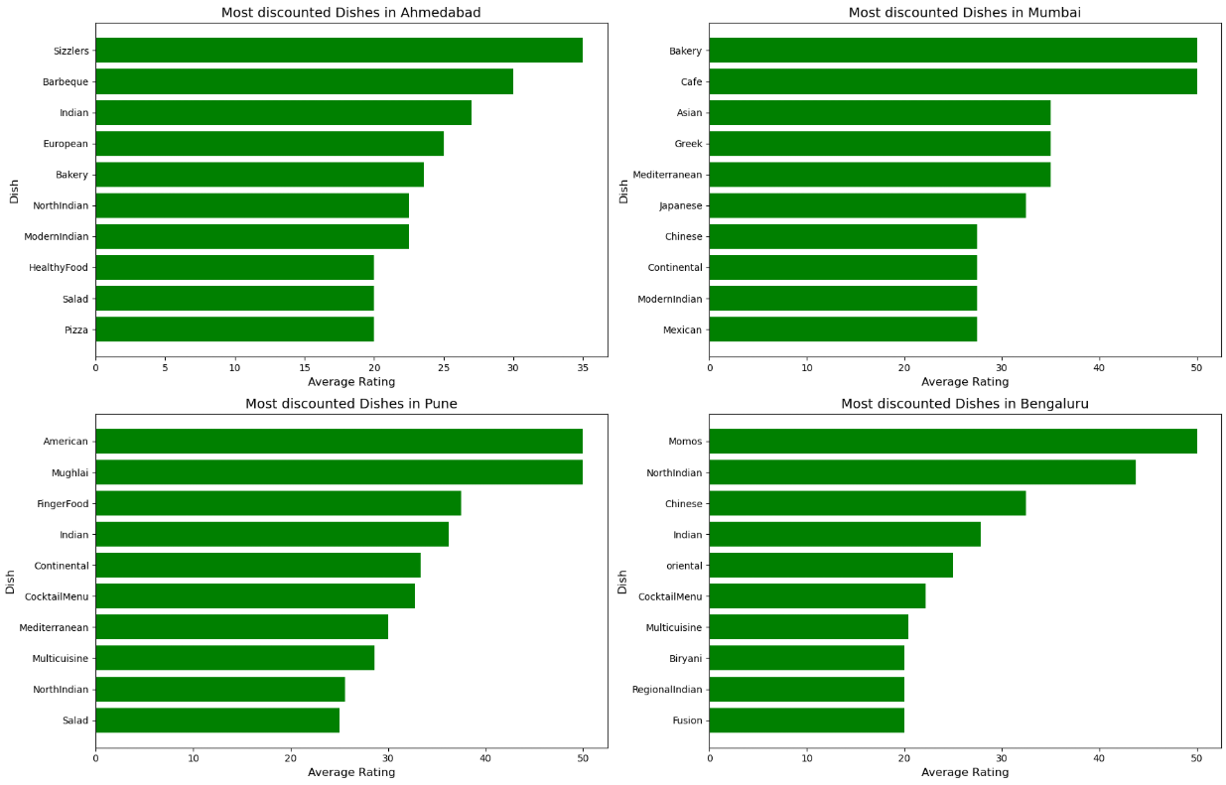
Most Discounted Dishes in each City

Slide 29
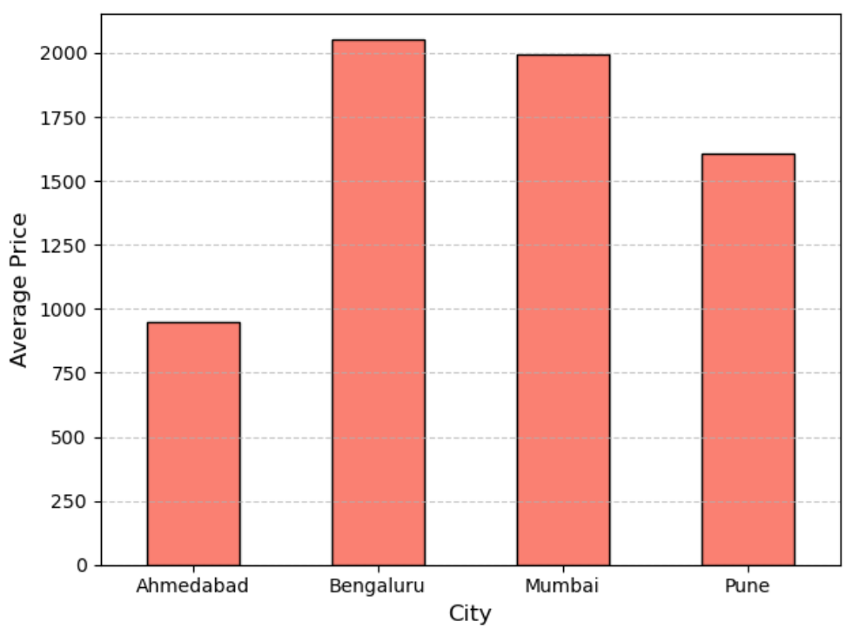
Average Price of Dining in each city

Slide 30
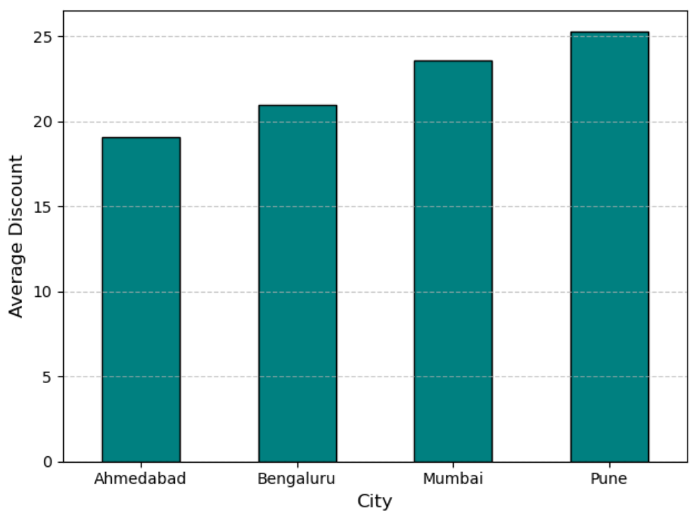
Average Discount for Dining in each city

Slide 31
Overall Conclusions / Takeaways :
Cuisine & Dish Popularity is City-Specific -
This helps understand regional food preferences for restaurant owners or food delivery startups.
Restaurant Pricing Varies Significantly Across Cities -
Indicates economic tier difference and spending behavior across metros.
Top-Rated Restaurants Are Clustering in Certain Areas -
Useful for real estate selection, franchise investment, or launching a new food venture.
Data-Driven City Guides Can Be Created -
The insights can power data-backed food guides, showing: Best-rated dishes, Most affordable locations, Cuisine trends city-wise.

Slide 32





Experience Highlights :
Gained hands-on experience with various Python libraries like requests, BeautifulSoup, NumPy, etc.
Understood the importance of HTML structure and how to extract structured data from dynamic websites.
Practiced end-to-end EDA including data cleaning, manipulation, visualization, and generating insights.
Developed a deeper understanding of consumer behavior patterns in the food industry.
Strengthened my data wrangling skills by handling inconsistent formats, missing values, and noisy data.
Challenges Faced :
Web structure inconsistency: Some pages had slightly different HTML tags, requiring dynamic parsing logic.
Scraping large volumes while managing response delays and avoiding rate limits.
Cleaning real-world messy data: Parsing approximate cost, cleaning cuisine/dish names, and handling non-standard values.
Deriving meaningful columns like “LOCATION” or cleaning “DISCOUNT” for consistent analysis.
Balancing visual clarity and insight: Choosing the right plots to represent categorical and numerical features meaningfully.

Slide 33

Any Questions

Slide 34

THANK YOU !

